Slide 1


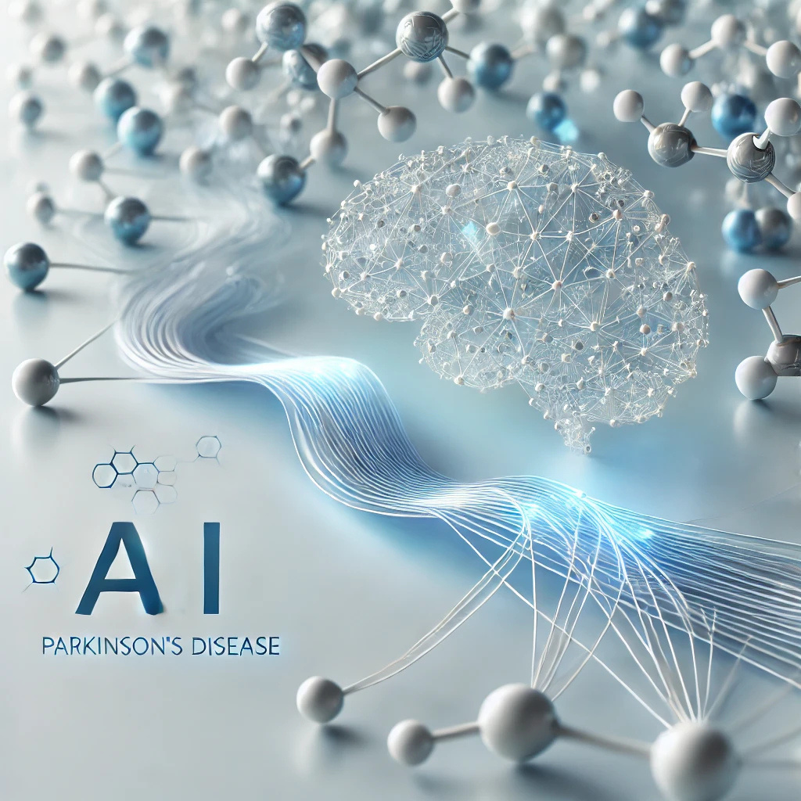




2nd Data Science & AI Summer School 2025
Python Programming
Instructor: Amos Aondover Kwaghfan
Teaching Assistants (TAs): Peter Denen Tsaha, Emmanuel Ocholi Benjamin and Terkuma Saaondo
June 27, 2025
+1 (678) 975-5615
www.neliref.org
contact@neliref.org
New Life Research Foundation (NELIREF) Ltd/Gte
Notes:
Good afternoon everyone!
Thank you for being here today.
We are Bio-PrecisionAI we’re passionate about changing the game in drug discovery using AI. Right now, we’re focused on developing small drug molecules for Parkinson’s disease, a condition that impacts over 10 million people worldwide and still doesn’t have a cure.
Our AI platform is designed to accelerate drug discovery, improve treatment outcomes, and address the urgent needs of patients. Now, we’d like to take you through how we’re turning this vision into reality.

Slide 2
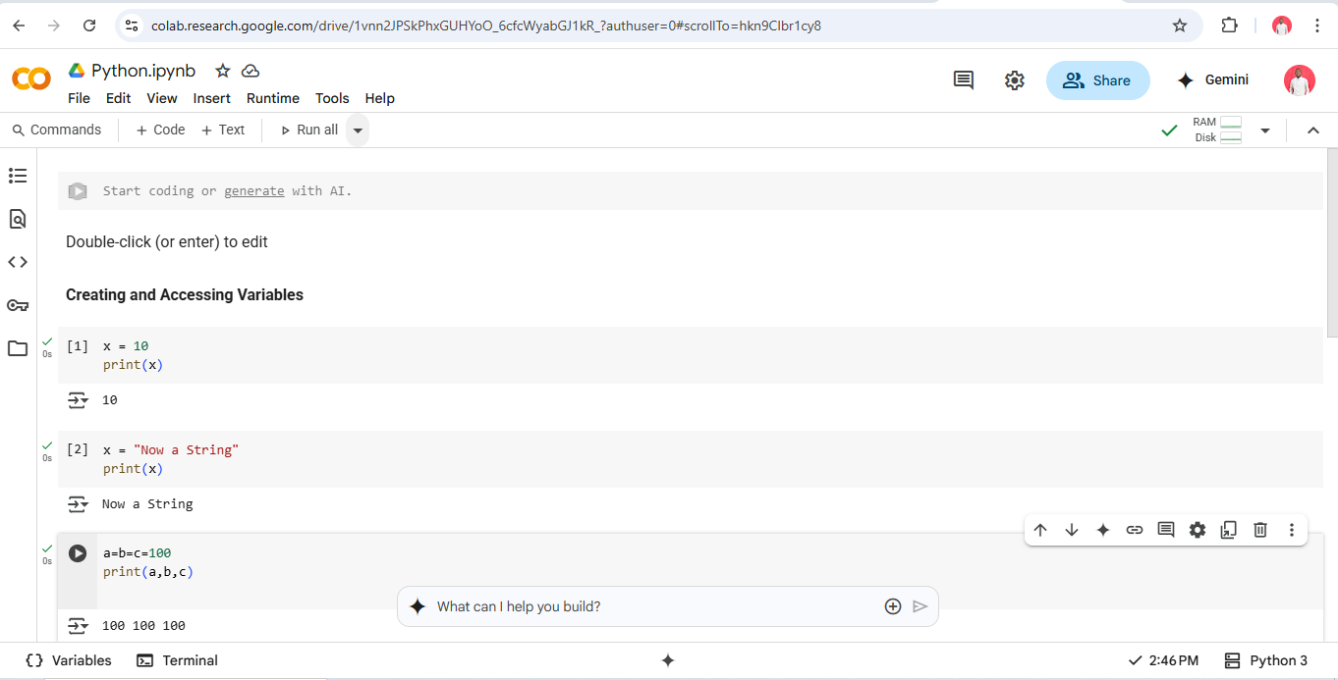
Python Jupyter Notebook

Slide 3
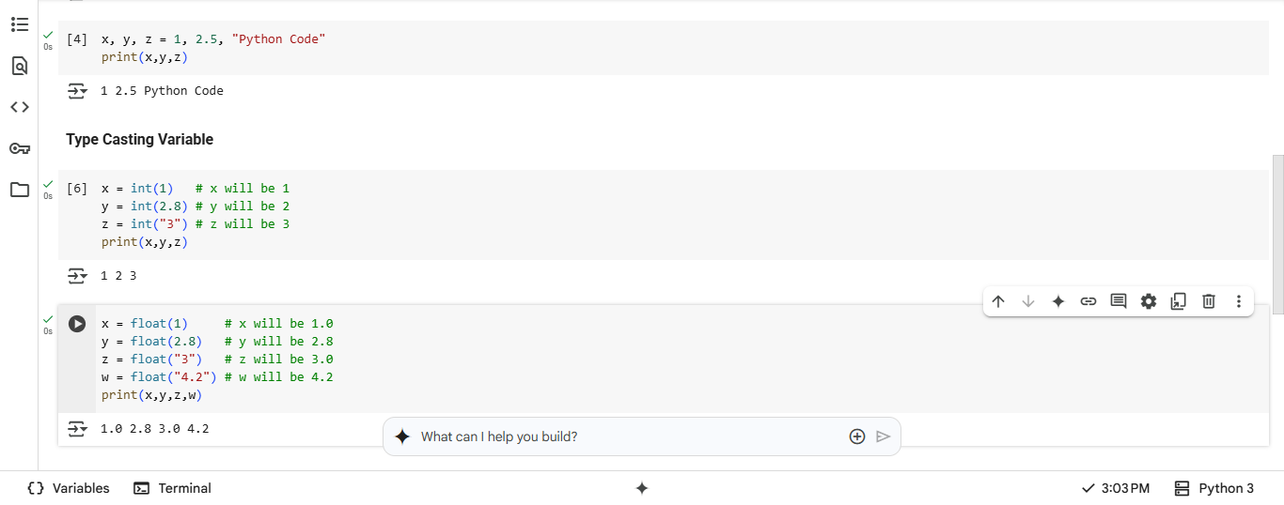

Slide 4
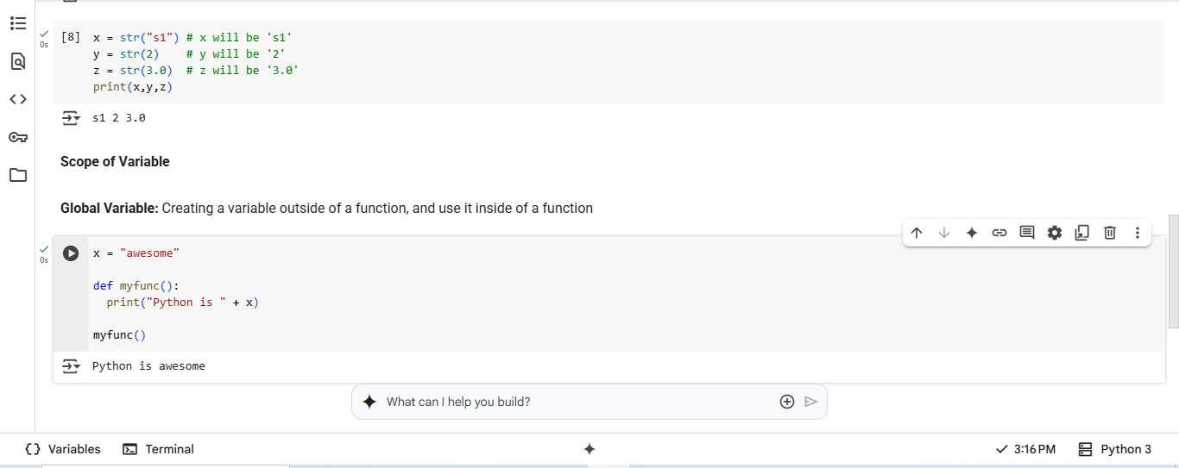

Slide 5
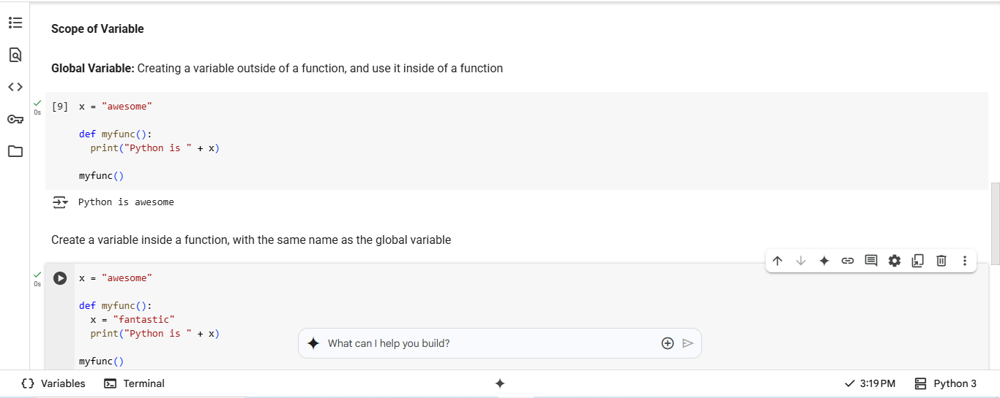

Slide 6
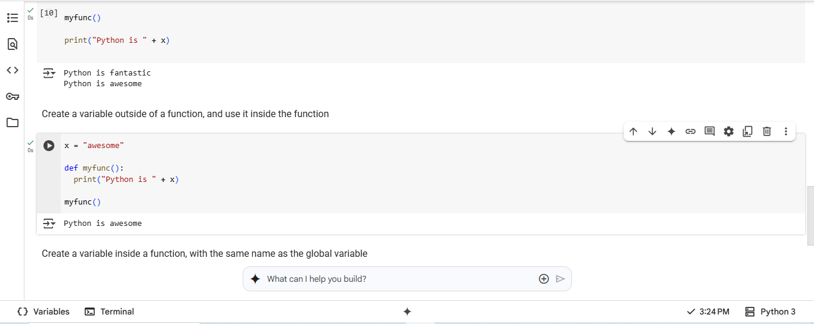

Slide 7
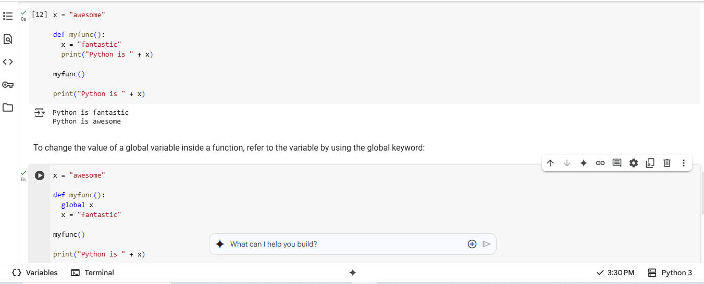

Slide 8
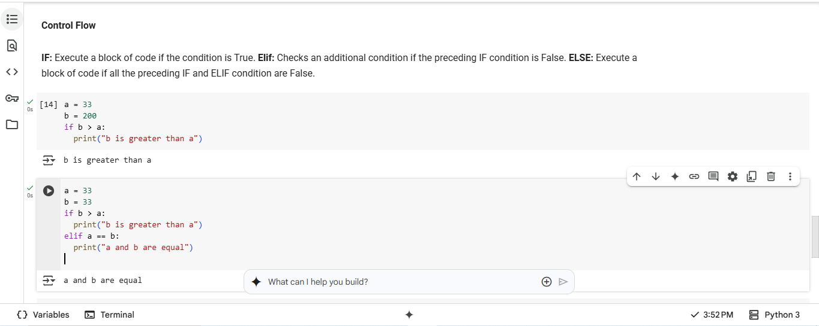

Slide 9
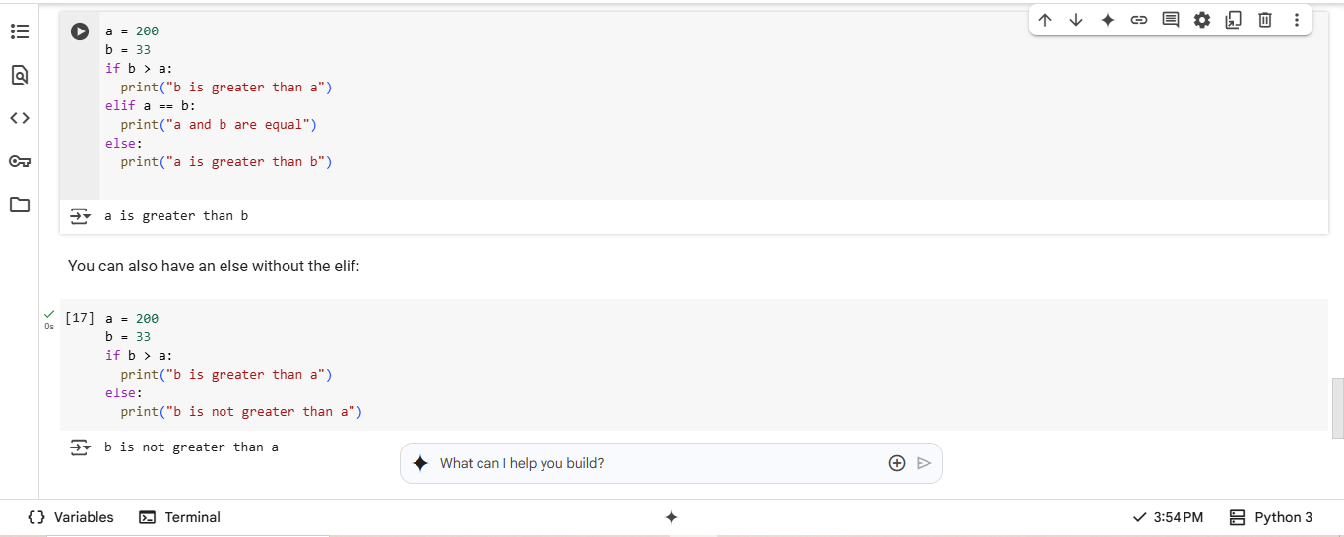

Slide 10
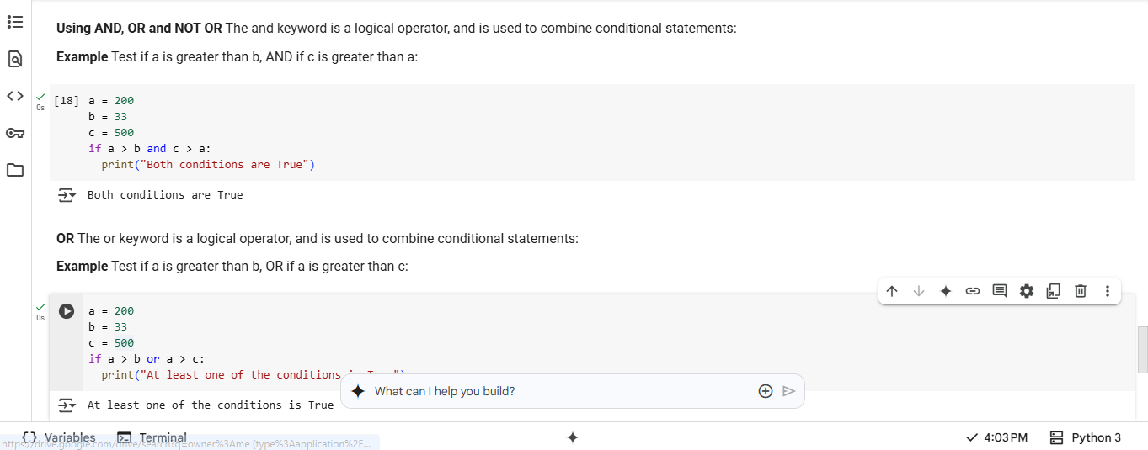

Slide 11
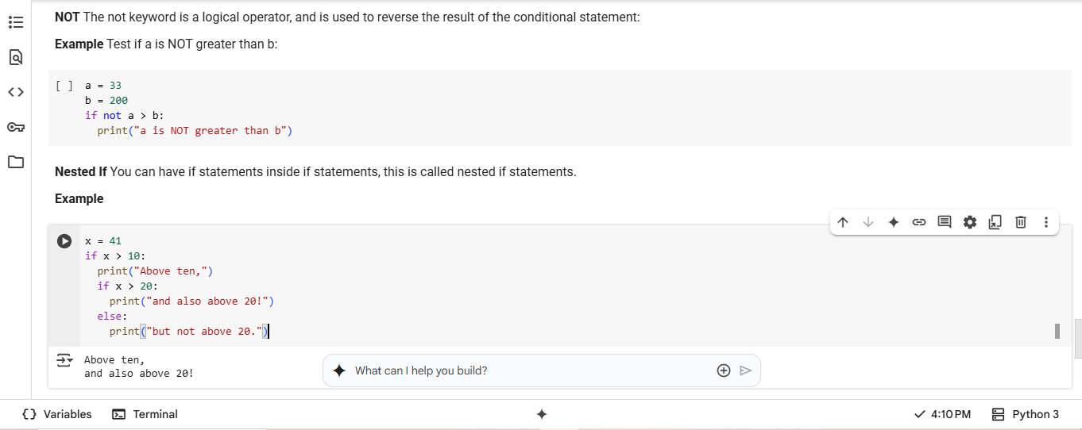

Slide 12
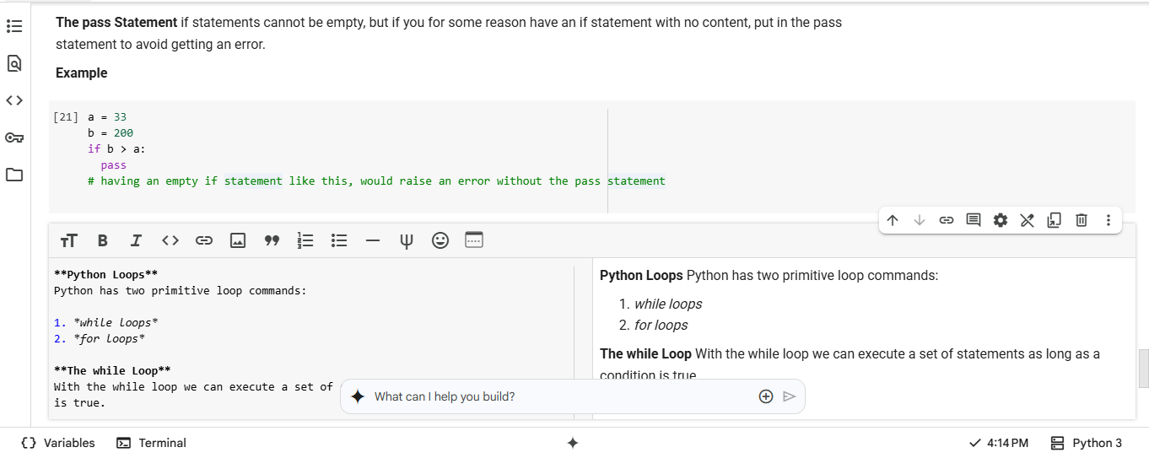

Slide 13
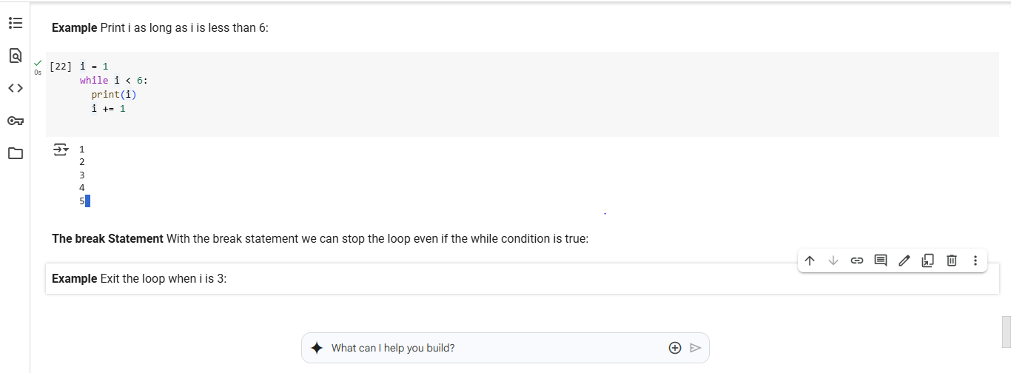

Slide 14
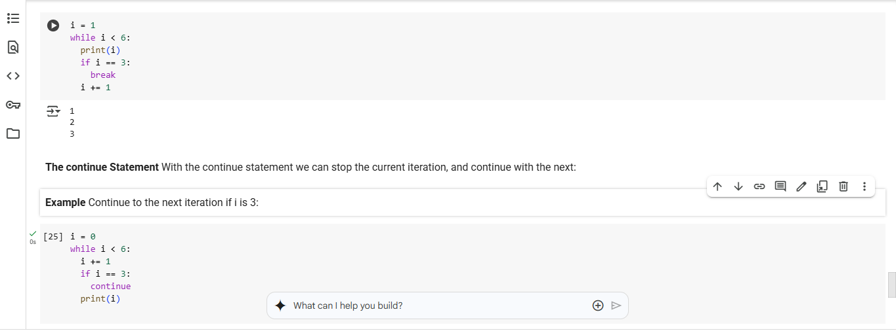

Slide 15
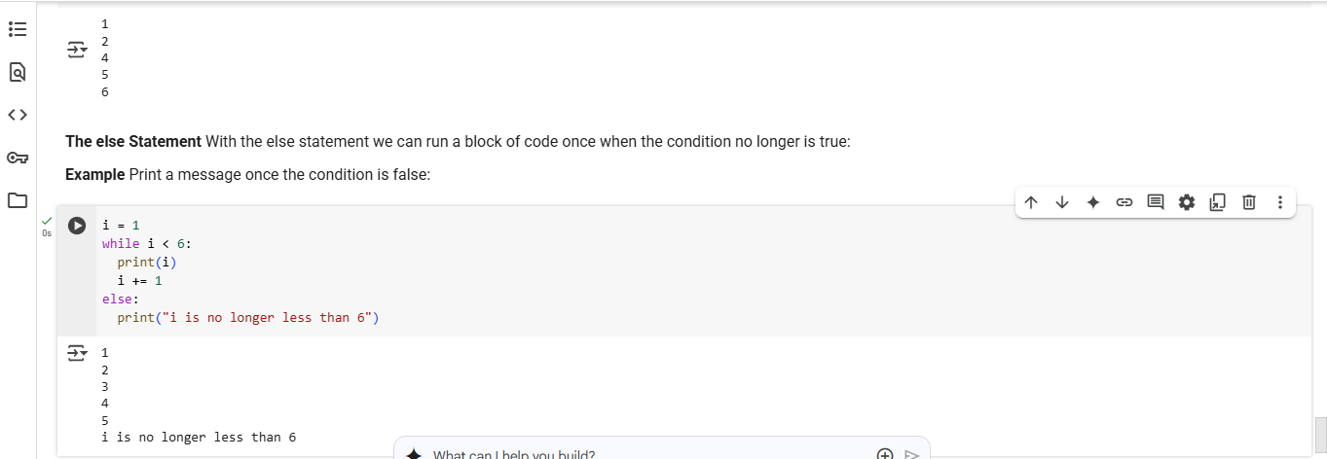

Slide 16











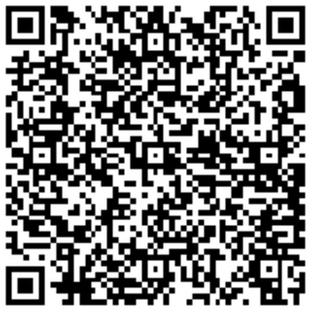
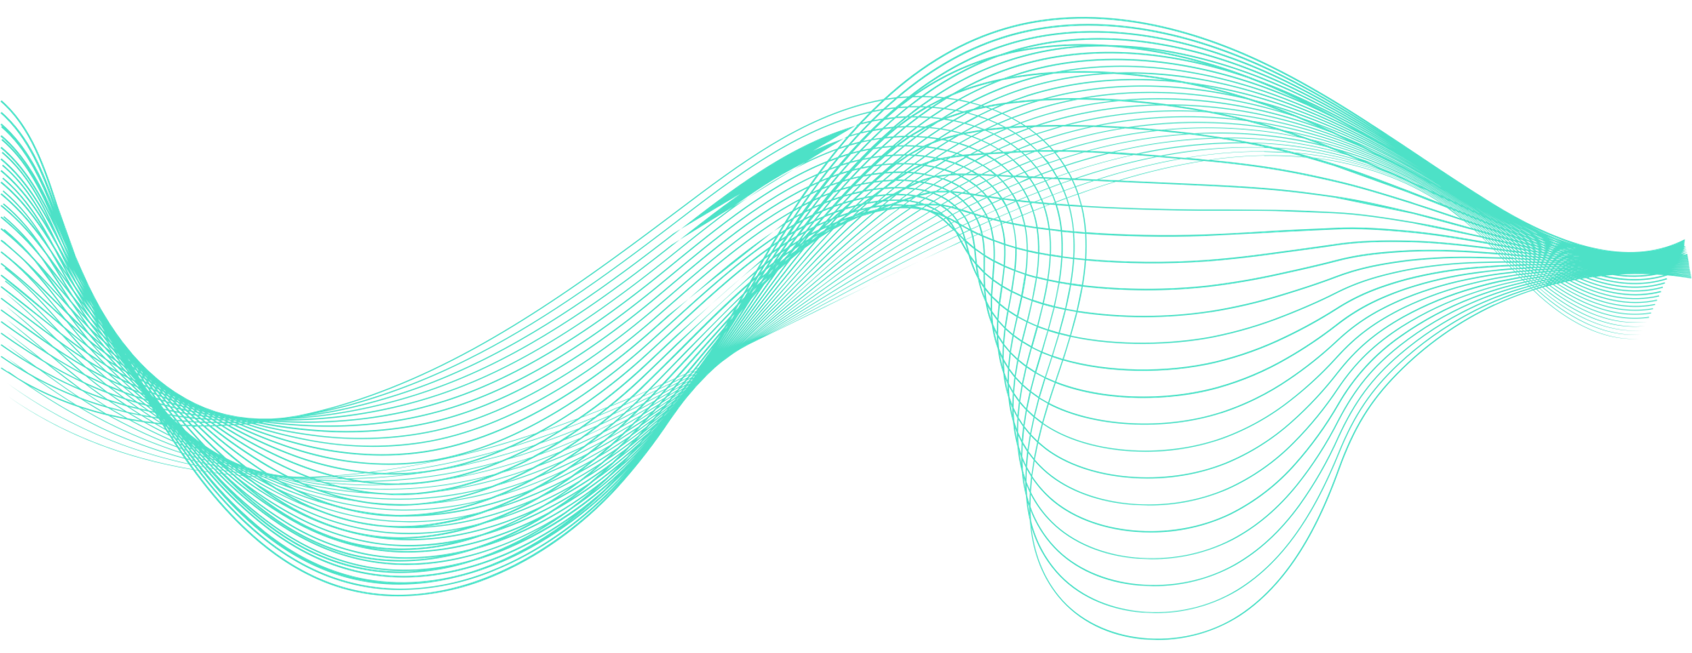

Thank You!
Connect with Us!
We admonish you to live for God and connect with our community!
New Life Research Foundation (NELIREF) Ltd/Gte
Contact @neliref.org newliferesearchfoundation2013@gmail.com
www.neliref.org
+1 (678) 975-5615

